Slide 1
Paper on Dielectric constants and 3D imaging
Yutong Zhao
Apr. 30th 2018

Slide 2
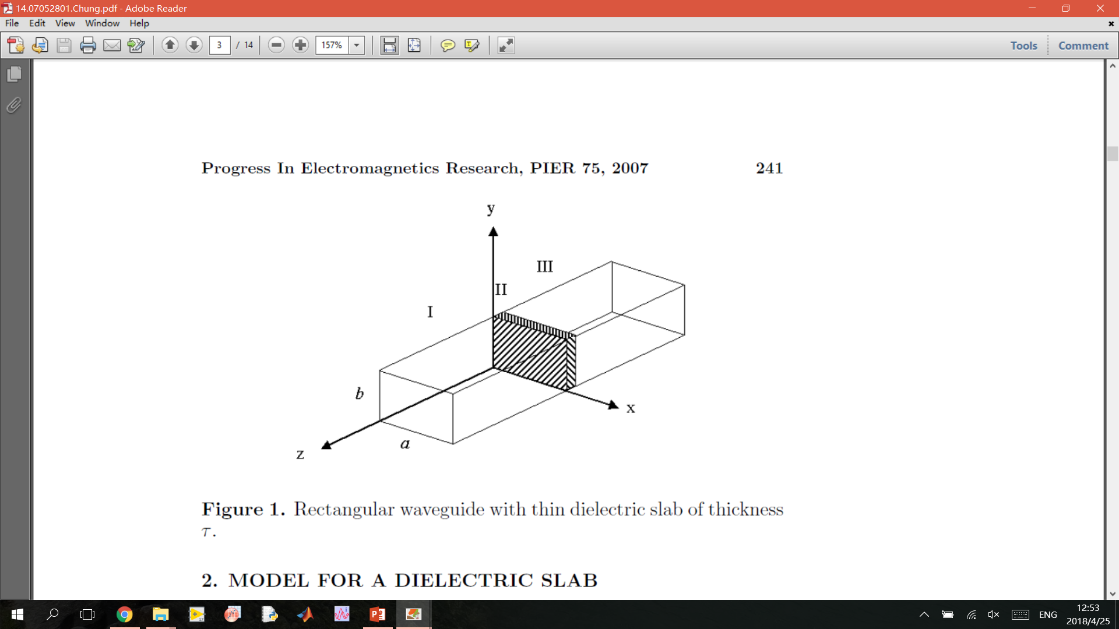
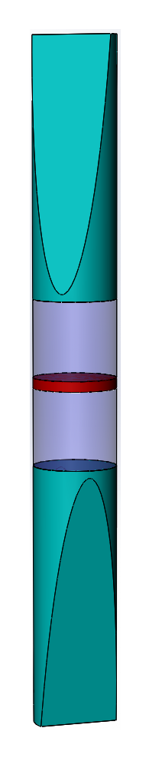
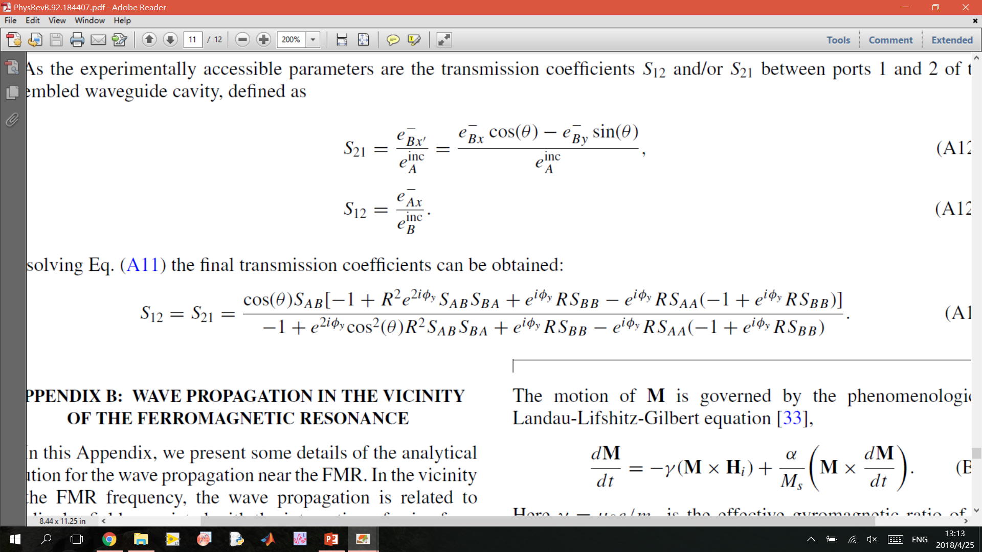
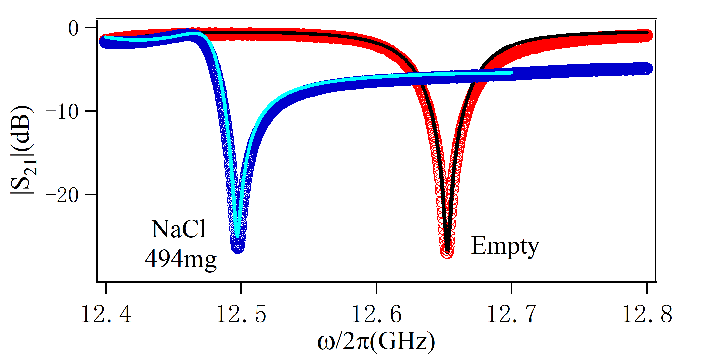
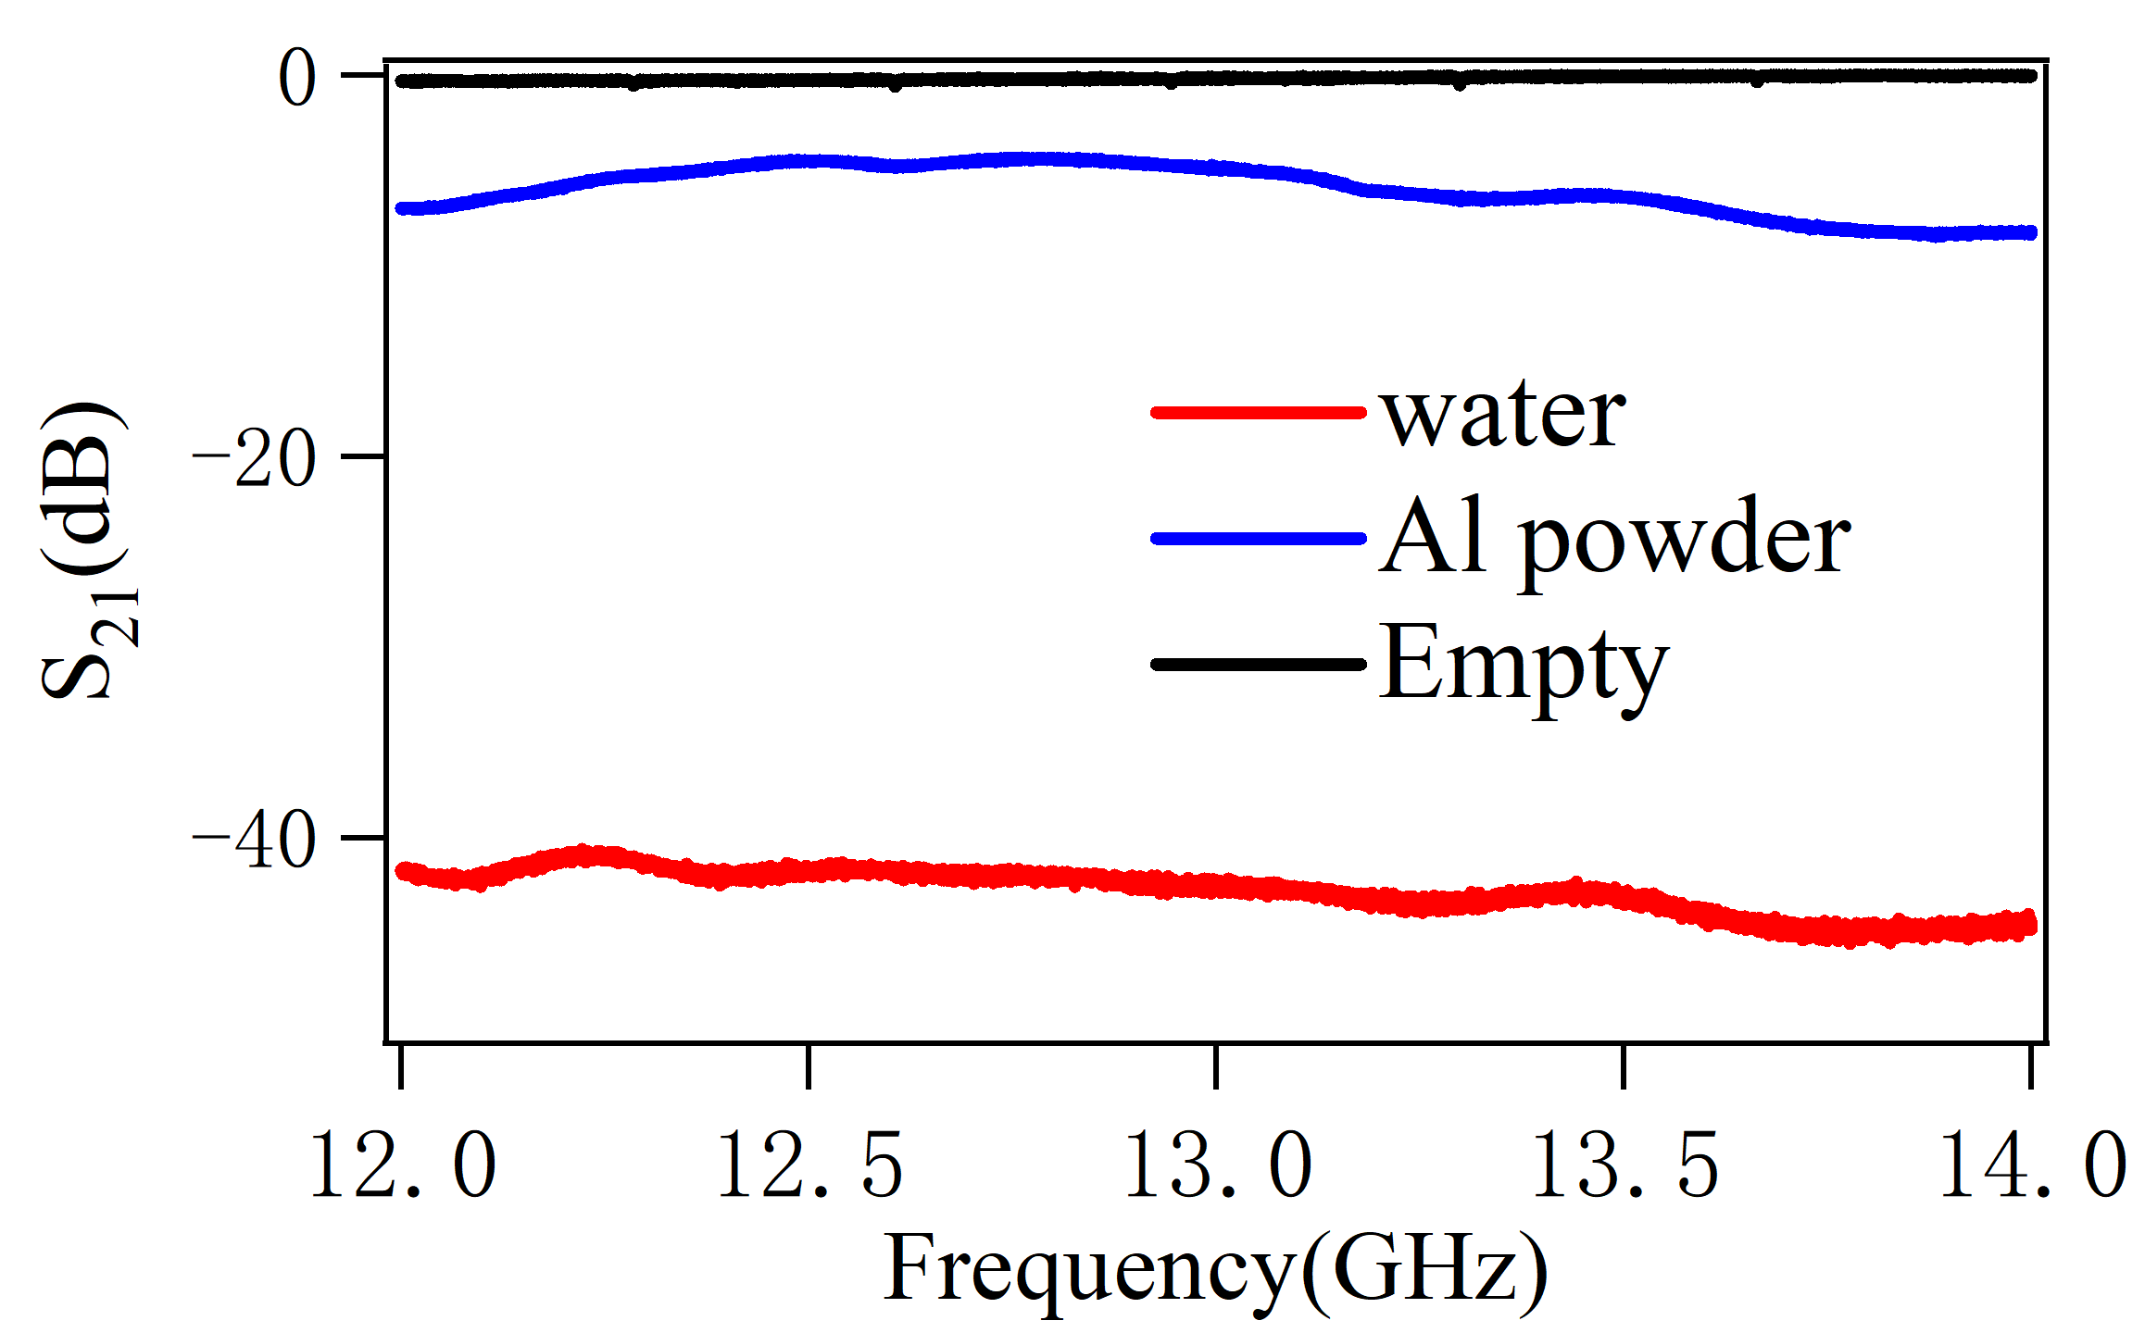
Dielectric constants
Relative permittivity at microwave frequencies(12 GHz -18 GHz)
Port 1
Port 2
Port 1
Port 2
VNA
VNA
$${{Tr(M}_{i}M}_{0}^{−1})=Tr{(T}_{refi}T_{i}T_{refi}^{−1}⋅T_{ref0}T_{0}^{−1}T_{ref0}^{−1})$$
Large
systematic
Error

Slide 3
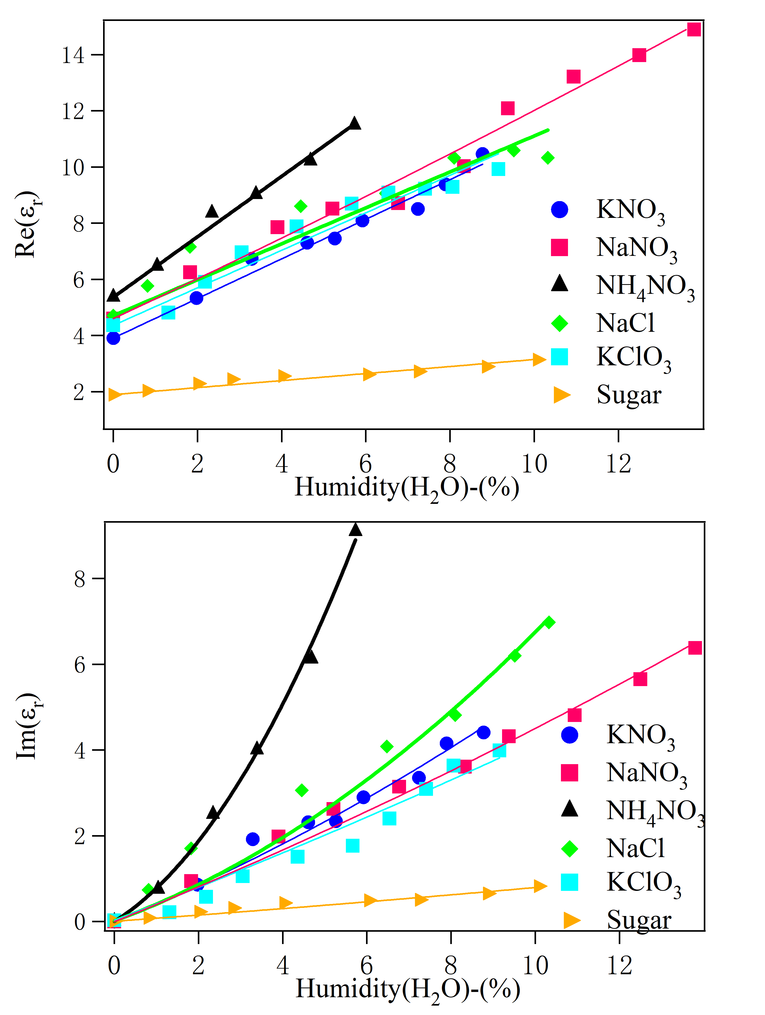
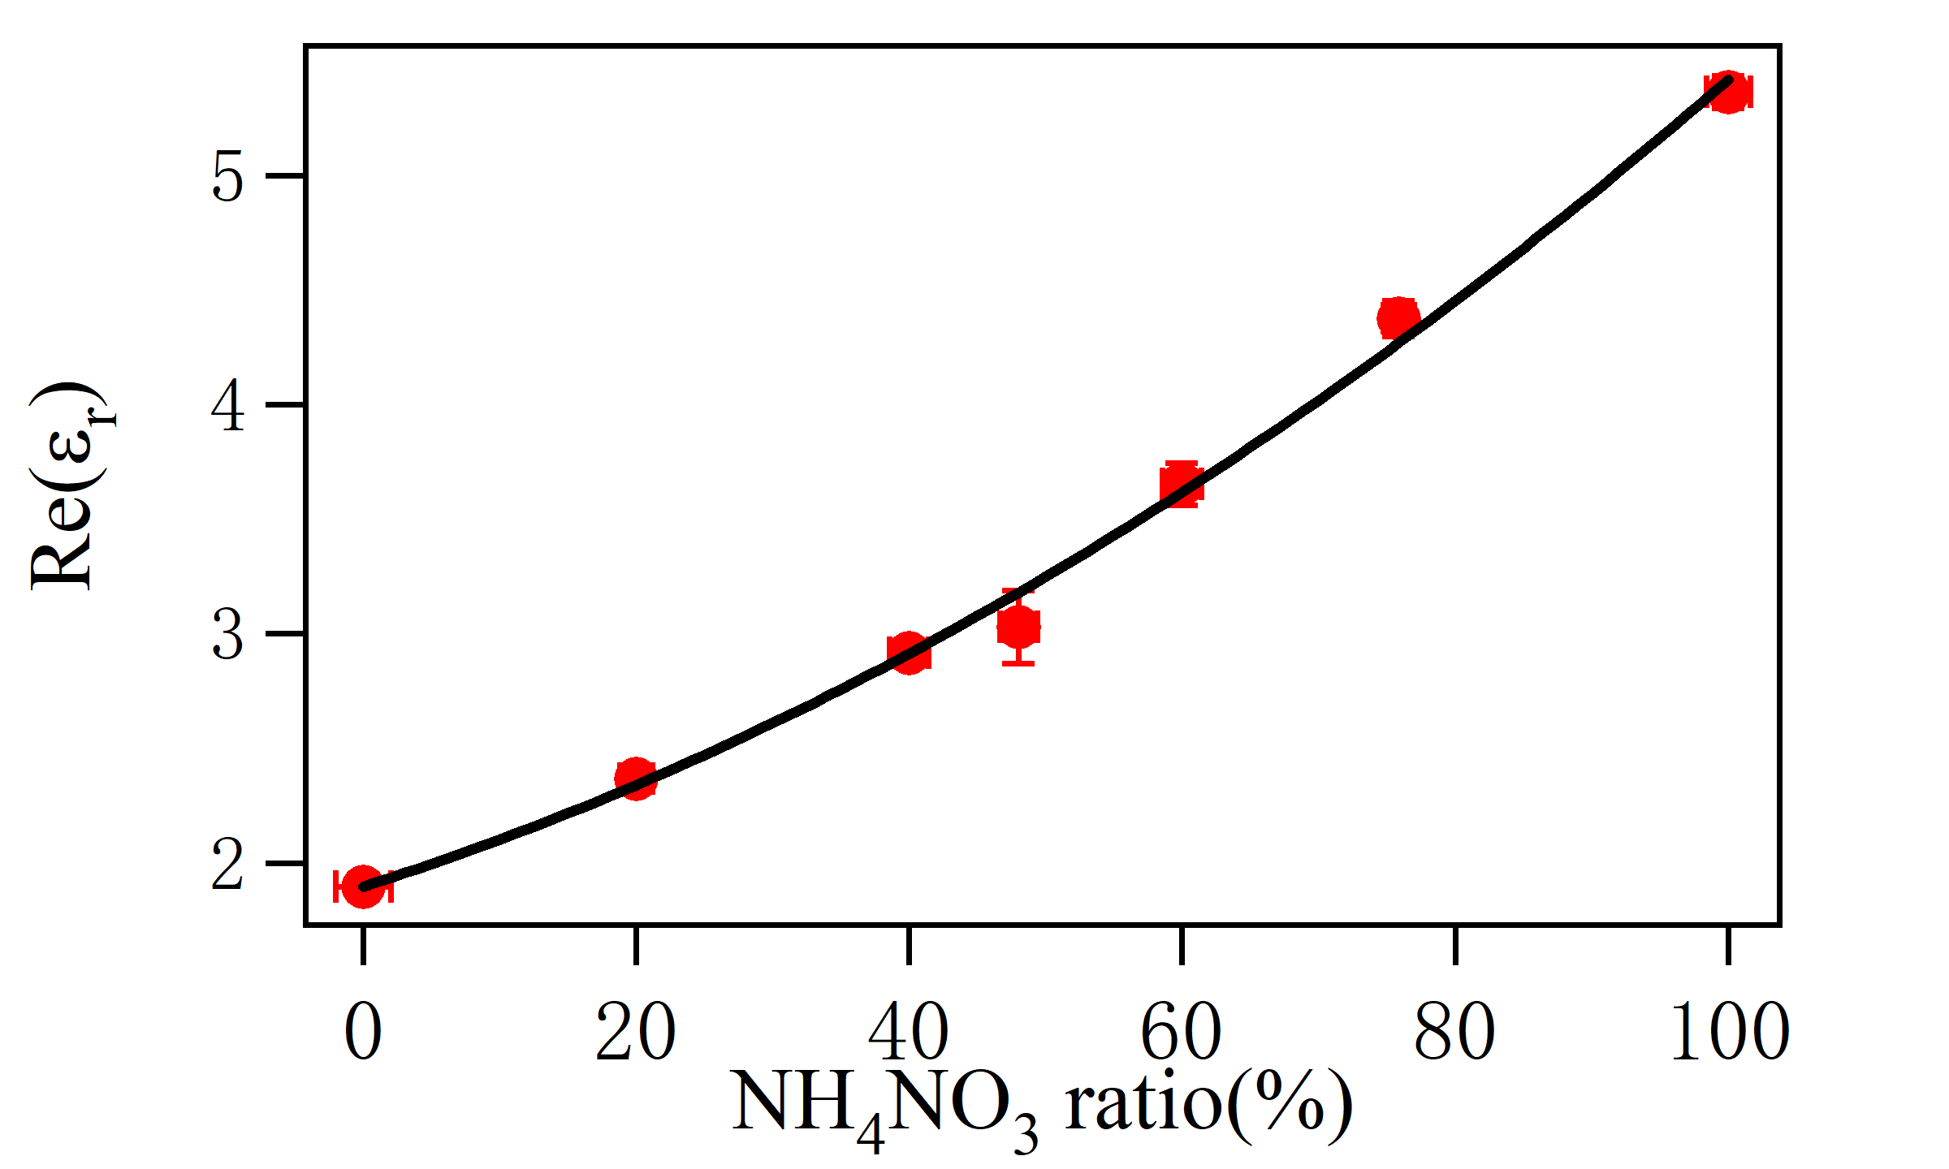
Empirical model for water content
$$ε=ε_{s}+aε_{w}w_{c}+bε_{w}w_{c}^{2}+i⋅αw_{c}^{2}$$
Water in Chemical powders
NH₄NO₃ in icing sugar

Slide 4
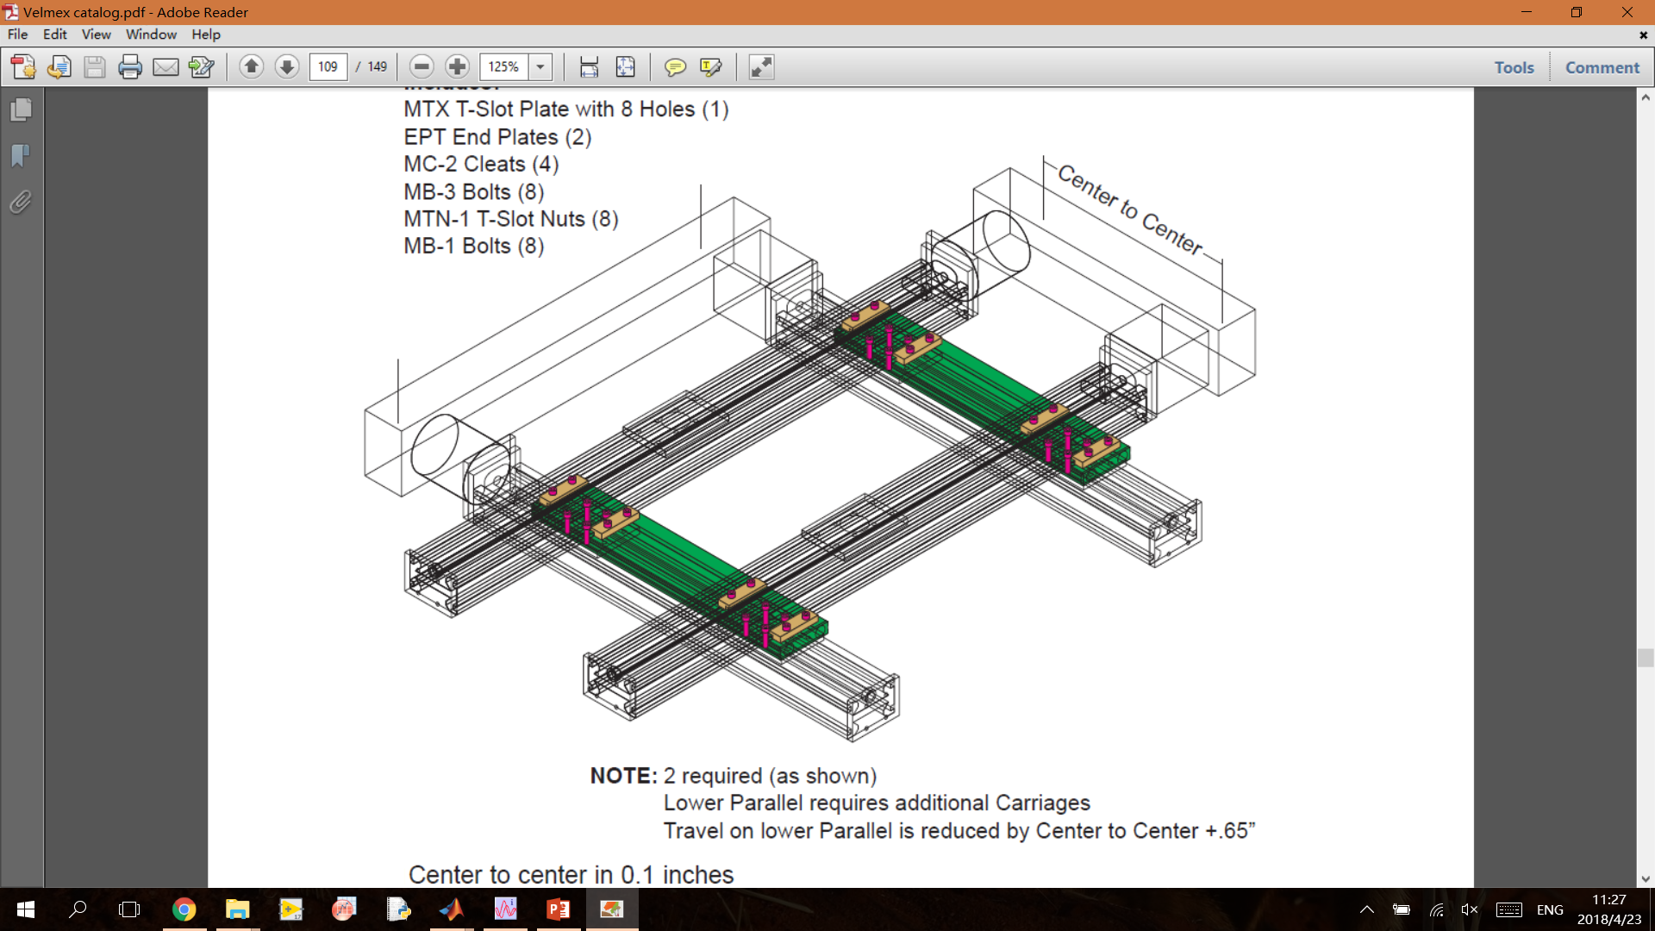
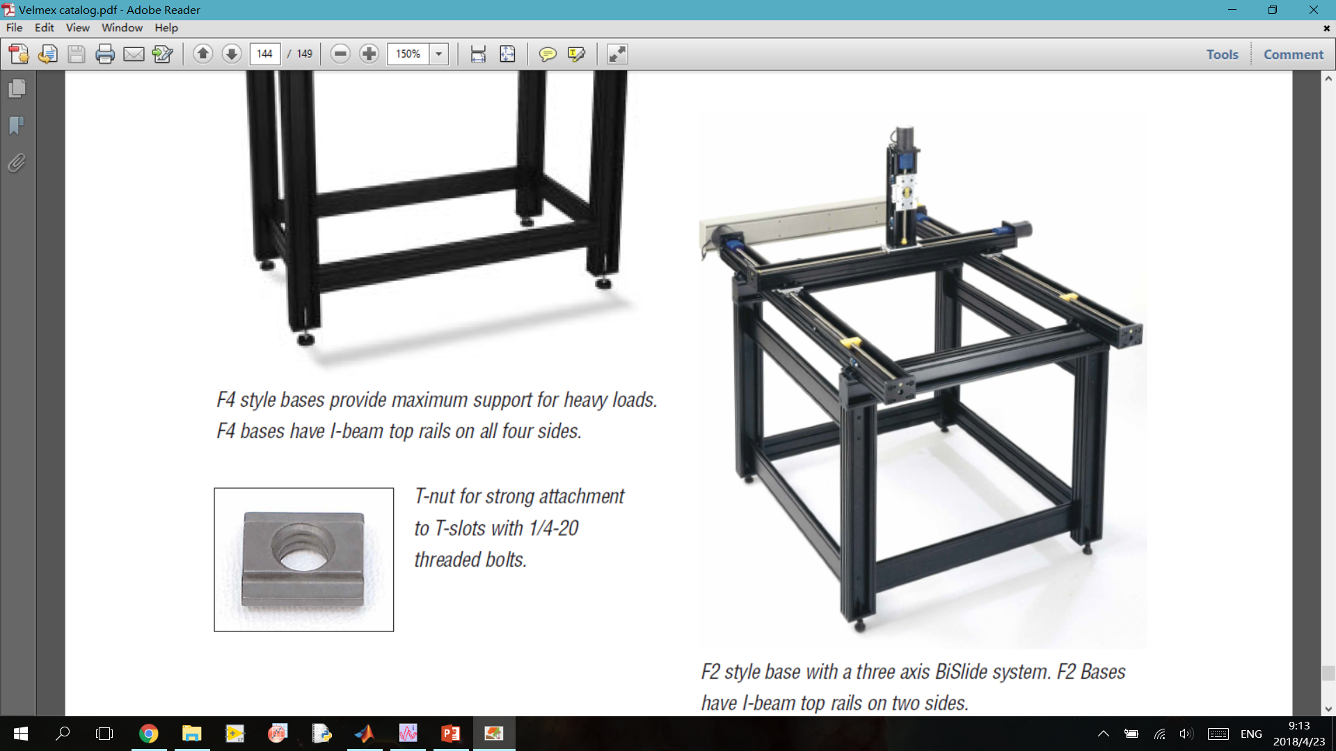
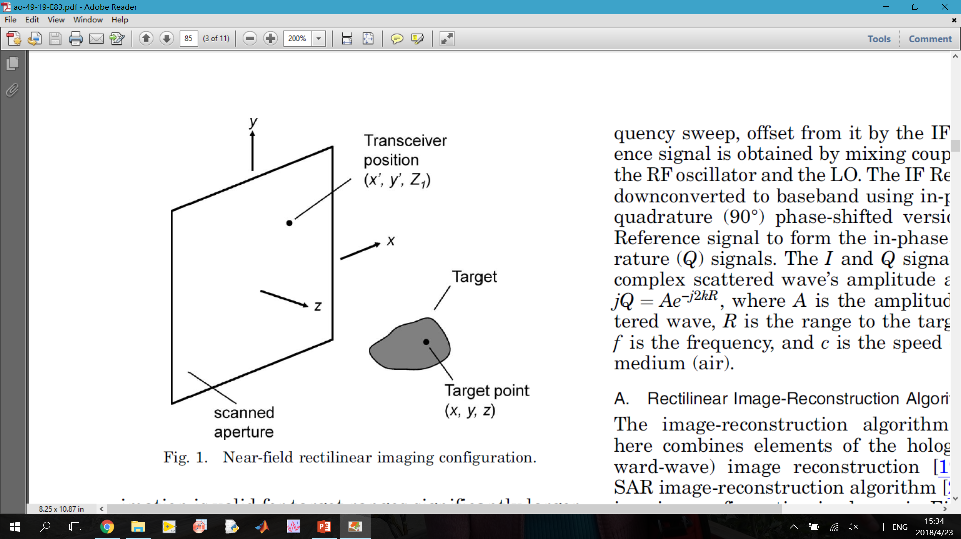
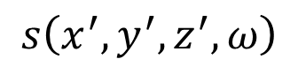
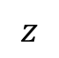
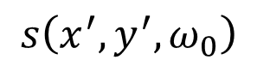
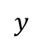
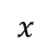
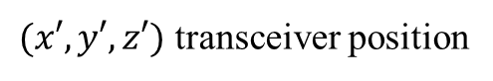
3-D Imaging
$$s\left(x^{′}, y^{′},ω_{0}\right)$$
$(x′,y′,z′)$ transceiver position
$$y$$
$$x$$
Scanned aperture
$$s\left(x^{′}, y^{′},z^{′},ω\right)$$
$$z$$

Slide 5
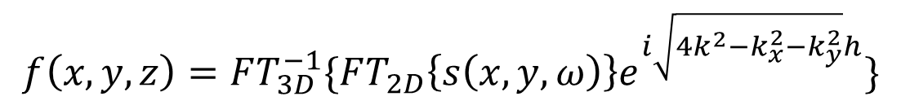
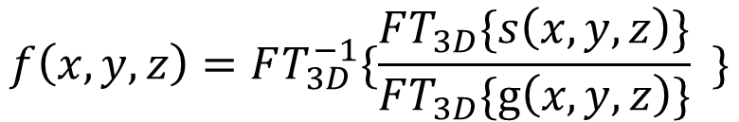
Algorithms
Reflectivity function
Phase shift
$$s\left(x,y,z\right)=∭f\left(x,y,z\right) e^{−2ik\sqrt{{\left(x−x^{′}\right)}^{2}+{\left(y−y^{′}\right)}^{2}+{\left(z−z^{′}\right)}^{2}}}dxdydz$$
(wide band)
(3-D scanning)
$$f\left(x,y,z\right)=FT_{3D}^{−1}\{FT_{2D}\left\{s\left(x,y,ω\right)\right\}e^{i\sqrt{4k^{2}−k_{x}^{2}−k_{y}^{2}}h}\}$$
$$f\left(x,y,z\right)=FT_{3D}^{−1}\{\frac{FT_{3D}\{s\left(x,y,z\right)\}}{FT_{3D}\{g\left(x,y,z\right)\}} \}$$

Slide 6
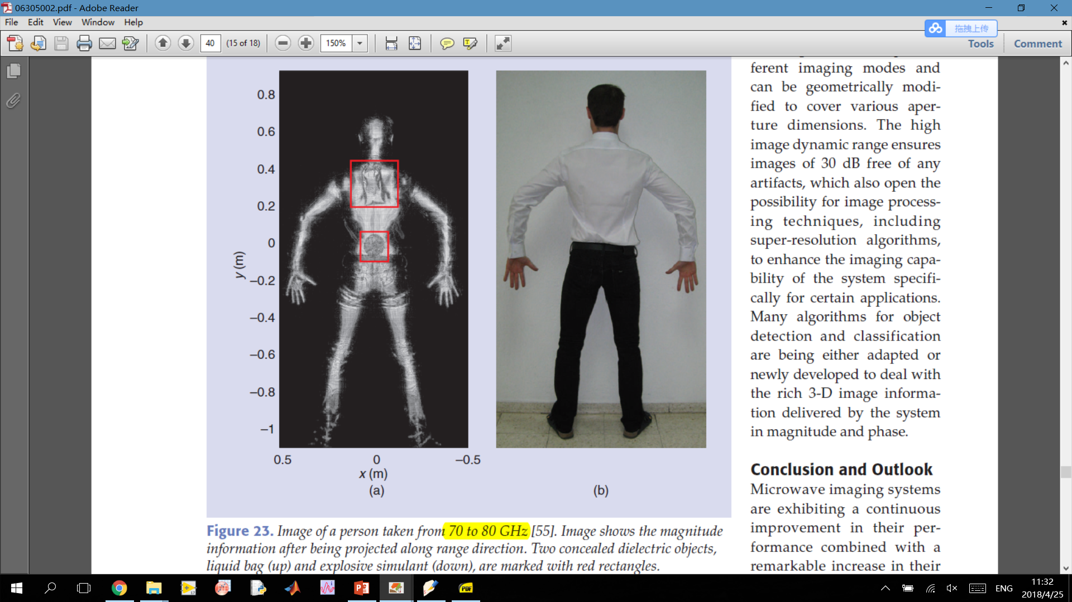
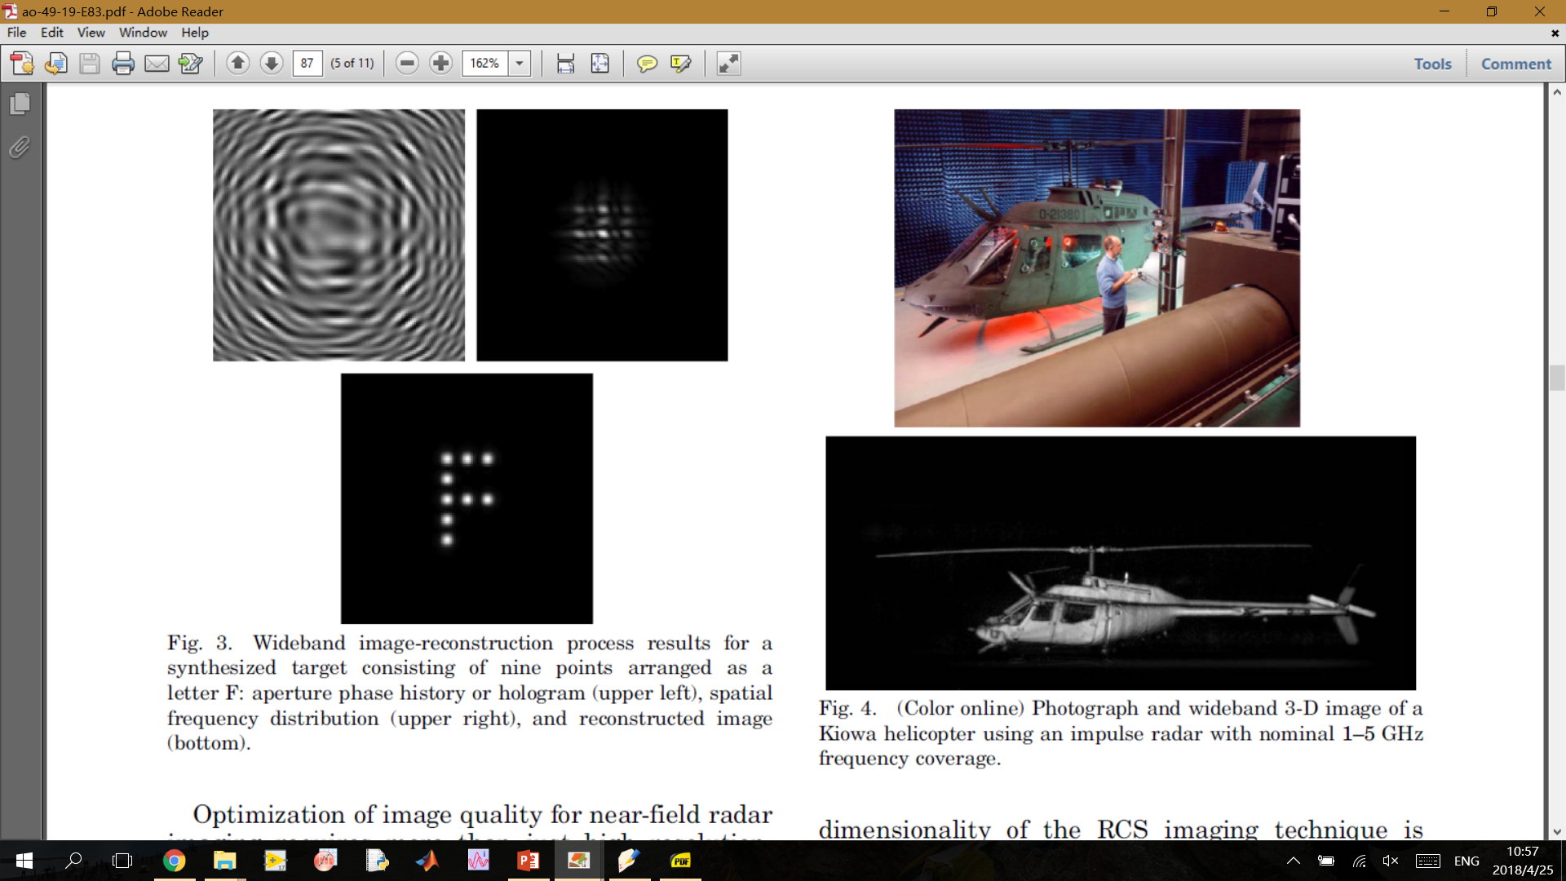
Reconstruction Images (wide band)

